Slide 1
Movie Master
A web based Movie quiz application
Team Z: HarRiët, Areg, David

Slide 2
The product backlog
Implemented user stories (MVP):
Start quiz
Show questions & (unique) answer options
Login & authorization token
Show aggregate quiz results
Not implemented user stories:
Unique questions for each quiz
Show correct/false questions at the end of the quiz
Timer per question
Game history for each profile
Show posters of movies
Two player mode

Slide 3
<demo>

Slide 4
Frameworks
Java backend: Spring
Spring data: repositories, hibernate, MySQL as database
Spring REST: Services, controllers
Spring security: …
Web based frontend
HTML
Javascript
Polymer: Ajax, styling

Slide 5
System Architecture
Repositories
Movie
QuestionType
Question
Quiz
Services
Question
Quiz
Option
Controllers
Question
Quiz
Frontend
Polymer
Datebase
JSON { }
JSON { }
Movie API

Slide 6
Data MOdel
Question Type
1
0..*
Quiz
Question
1
0..*
0..*
1
Movie

Slide 7
Security features

Slide 8
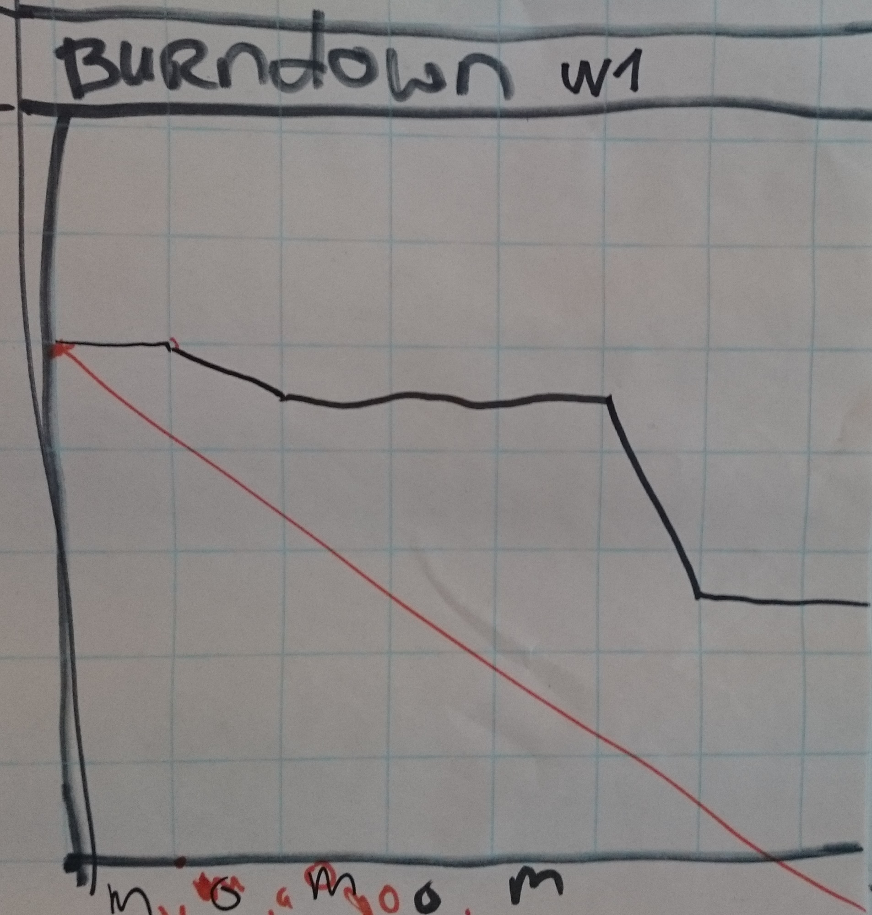
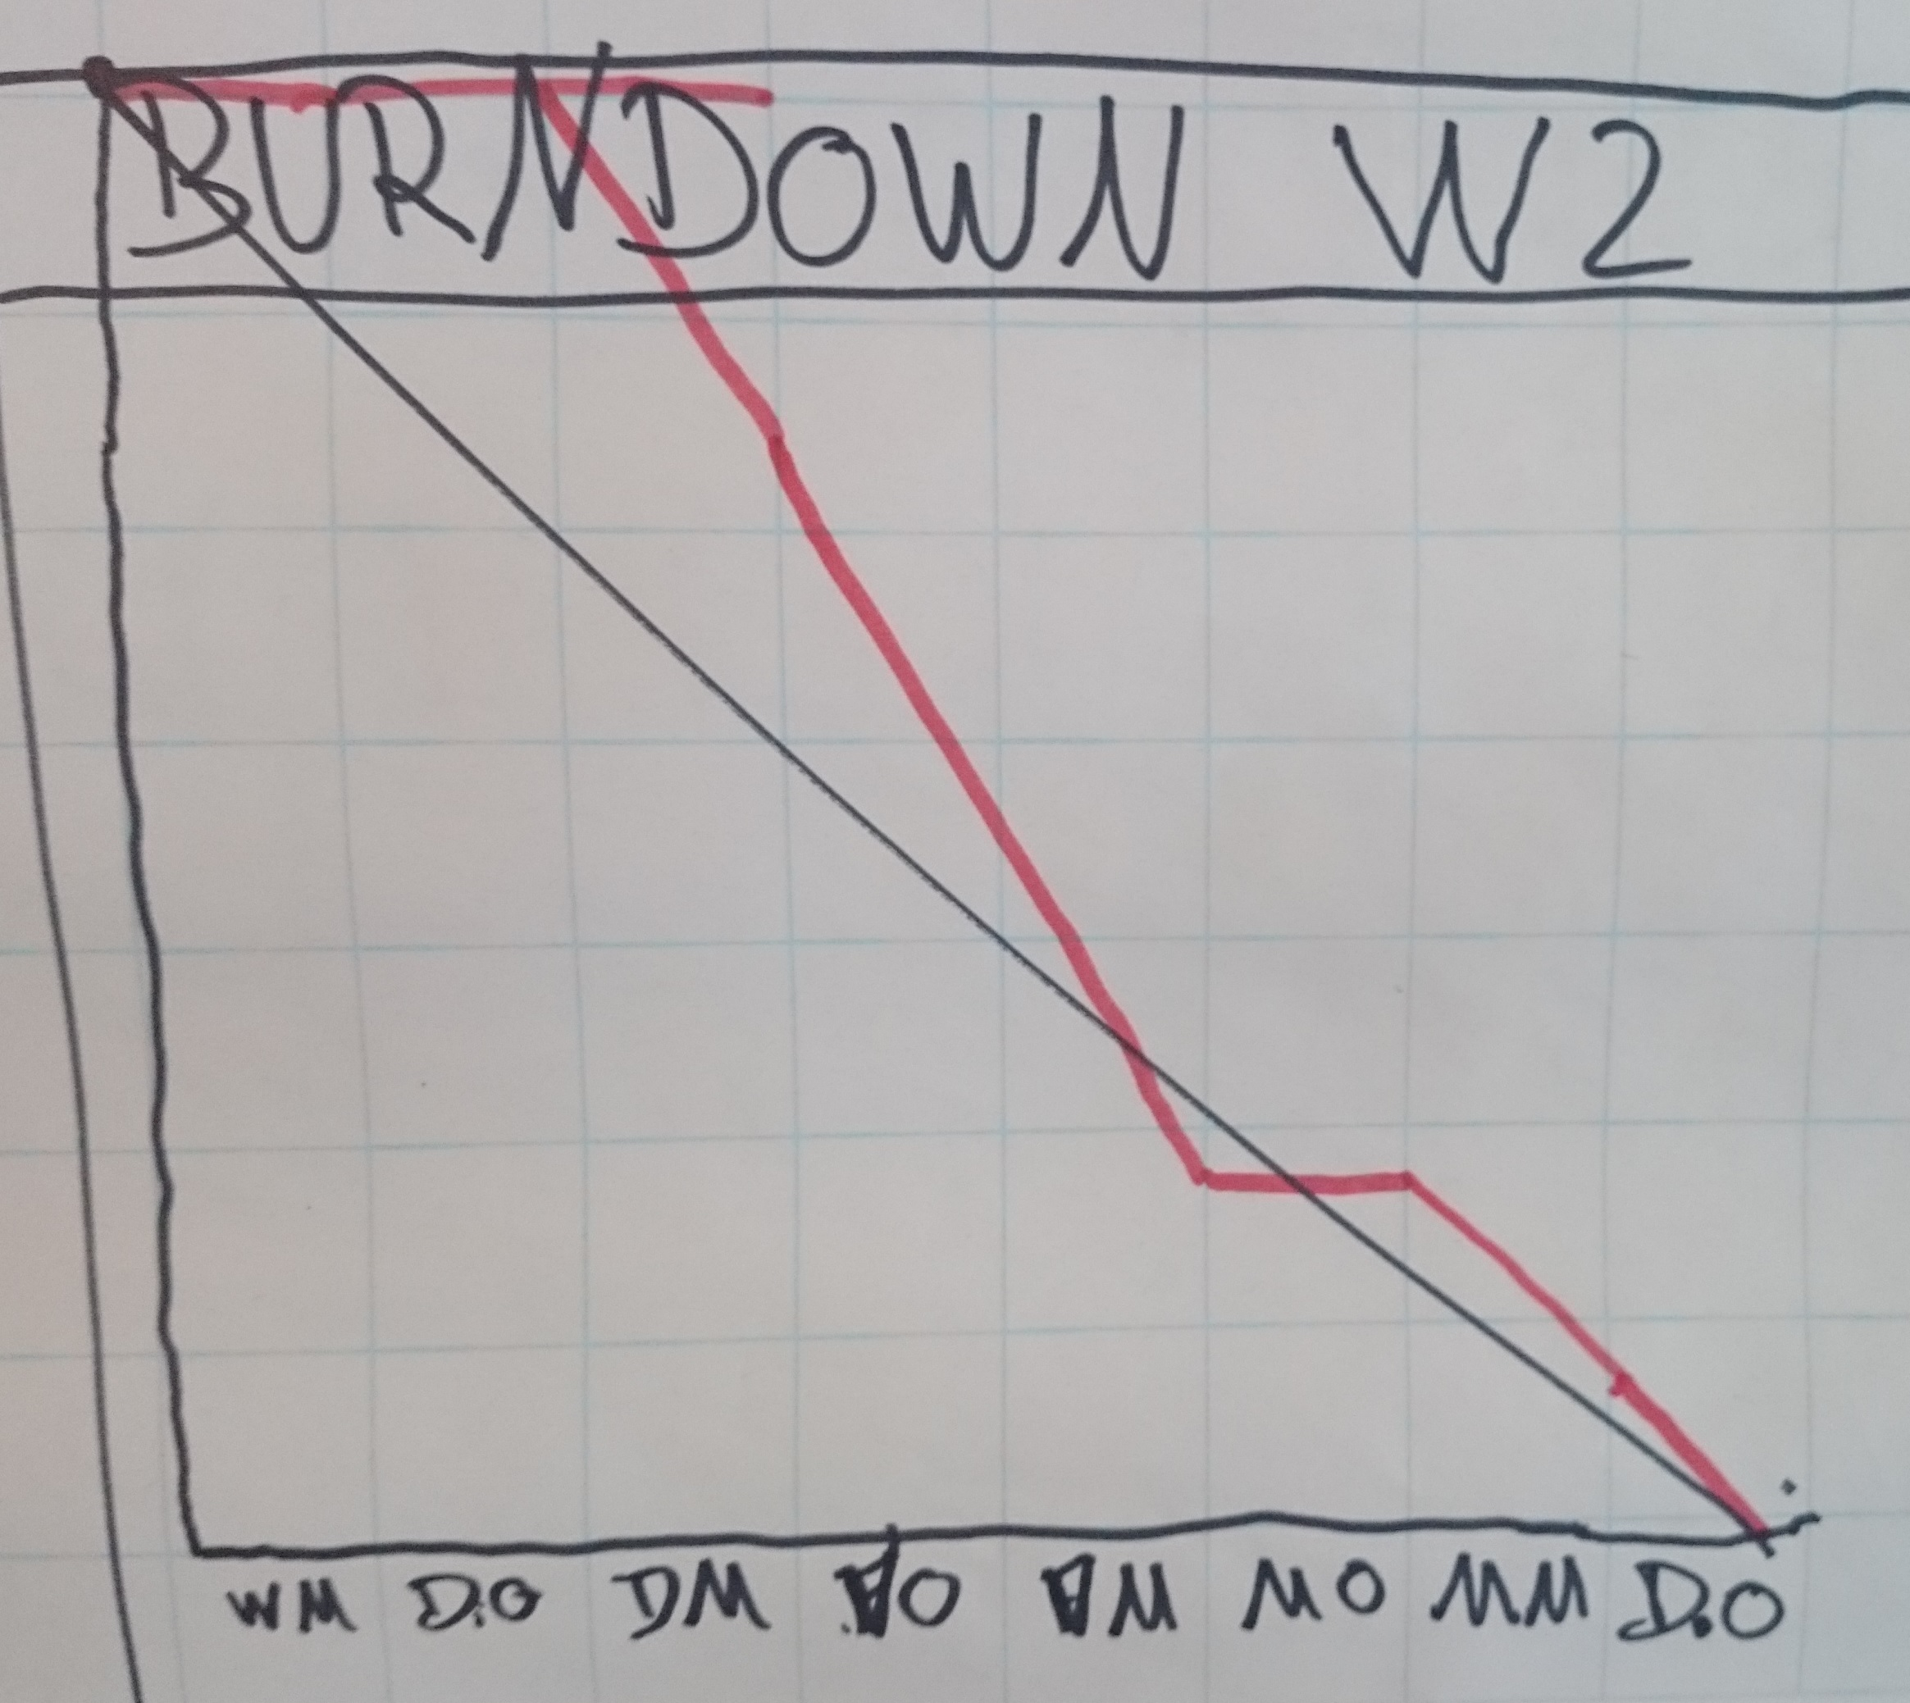
Sprint reviews
Improvements during second sprint
More manageable user stories
Defining tasks during sprint planning

Slide 9
Lessons learned
SCRUM process
Architecture of web application (services, controllers, database)
RESTful design
Usage of Git

